Slide 1
Financial Literacy Seminar Series _______________________________________
Income Growth and Distributional Effects of Urban Spatial Sorting
Erik Hurst
University of Chicago

Slide 2
Income Growth and the Distributional Effects of Urban Spatial Sorting
Victor Couture, Cecile Gaubert, Jessie Handbury and Erik Hurst
April 2019

Slide 4
Three Motivating Facts
The last few decades in the U.S. have seen:
Sharp growth in income inequality, driven by the top
Higher income individuals moving towards urban centers
Renewed discussion of neighborhood change within urban areas
� Anti-gentrification protests in SF, Chicago, Portland, Atlanta
� NYC: new zoning policies to slow down gentrification

Slide 5
Three Motivating Facts
The last few decades in the U.S. have seen:
Sharp growth in income inequality, driven by the top
Higher income individuals moving towards urban centers
Renewed discussion of neighborhood change within urban areas
� Anti-gentrification protests in SF, Chicago, Portland, Atlanta
� NYC: new zoning policies to slow down gentrification
⇒ This paper:
� How much does the increasing incomes of the rich contribute to neighborhood change?
� Develop novel mechanism linking top income growth, spatial sorting, and neighborhood change.

Slide 6
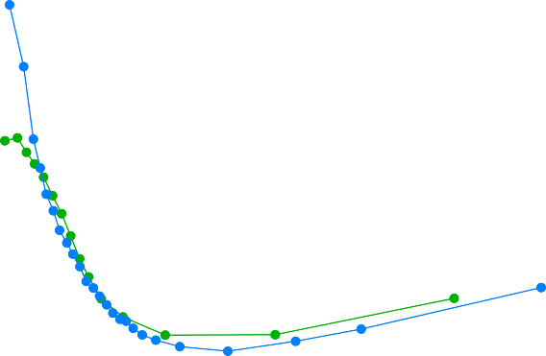
Propensity to Live Downtown is U-Shaped in Income
Share of Income Bracket in Urban Tracts (Normalized*)
2.5
Census data
Top 100 CBSA
Family income
Constant 1999 dollars
Downtown = constant geography
Tracts closest to center
• = 10% of pop. in 2000
2
1 1.5
.5
0
100000 200000
Median Family Income (1999 US$)
300000
1970 1990
*Normalized by aggregate urban share: 0.17 in 1970, 0.10 in 1990, and 0.08 in 2014

Slide 7
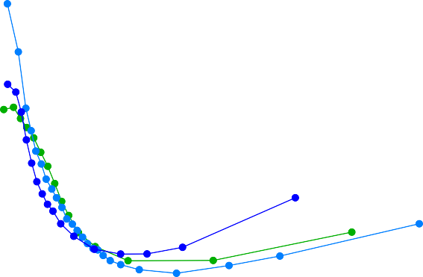
Propensity to Live Downtown is Increasingly U-Shaped in Income
Share of Income Brackets in Urban Tracts (Normalized*)
2.5
2
1.5
1
.5
0
100000
200000
300000
Median Family Income
1970 1990 2014
Normalized by aggregate urban share: 0.17 in 1970, 0.1 in 1990, and 0.08 in 2014

Slide 8
What We Do
Develop spatial equilibrium model
� Goal = Model U-shape in location choice, and its evolution
� Agents have common non-homothetic preferences, model generates non-monotonic sorting patterns
� Neighborhood change: endogeneous amenities of urban locations
Quantify model with micro data
Study counterfactuals:
� How much do increasing incomes of the rich contribute to neighborhood change and change in U-shape (within CBSA spatial sorting by income)?
� Effect on welfare inequality
� Impact of policies aimed at mitigating neighborhood change

Slide 9
Mechanism: Luxury Amenities + Top Income Growth
As individuals at the top of income distribution get richer:
� Some newly wealthy households move downtown to have better access to luxury urban amenities
� Housing prices and amenity provision respond endogenously
� Influx of the rich into urban areas yields pecuniary externalities by driving up housing prices
Poor urban incumbents (mostly renters) become worse off:
� Pay higher rents for amenities they do not value as much if they stay downtown
� Or migrate out to suburbs
Implication: Growth in income inequality can understate growth in well-being inequality, when spatial sorting responses are ignored.

Slide 10
Preview of Results
Between 1990 and 2014, the income gap grew by 22%.
Change in income distribution, with resulting neighborhood change, can explain a substantial part of the urbanization of the rich since 1990.
Growth in measured income inequality understates growth in welfare inequality.
� Well-being gap grew by an additional 2p.p., accounting for spatial reponses.
� Spatial responses are on net welfare-decreasing for lower income renters.
Location-based policies can help mitigate neighborhood change and spatial sorting, but impact on well-being gap is limited.

Slide 11
Literature Review
Within-City Sorting with Income Heterogeneity : LeRoy and Sonstelie (1983), Brueckner et al. (1999), Glaeser et al. (2008), Gaigne et al. (2017), Fogli and Guerrieri (2018)
Cross-City Sorting with Income Heterogeneity : Gyourko et al. 2013 (superstar cities), Moretti 2013 (real wage inequality), Diamond 2016 (endogenous amenities)
Quantitative Spatial Models, Trade: Redding and Rossi-Hansberg(2017), Fajgelbaum et al. (2011), Fajgelbaum and Gaubert (2018), Tsivanidis (2018)
Consumer Cities: Glaeser et al. 2001
Causes of Neighborhood Change: Rosenthal (2008), Guerrieri et al. (2013), Edlund et al., (2017), Baum-Snow and Hartley (2017), Ellen et al. (2017), Su (2017), Couture and Handbury (2017)
Consequences of Neighborhood Change: Lester and Hartley 2014 (jobs); Behrens et al. 2017 (businesses); Meltzer and Ghorbani 2017 (commute time); Autor et al. 2017 (crime); Vigdor et al. 2002, Freeman 2005, McKinnish et al. 2010, Waights 2014, Ding et al. 2016, (displacement); Brummet and Reed 2018; Su 2017

Slide 12
Focus of the paper
Our goal is to study the effect of rising income inequality on neighborhoods and (in turn) welfare.
This mechanism is not the only explanation for urban gentrification:
Demographics and delayed family formation (Couture and Handbury 2017)
The U-shape over time is almost identical including controls for family structure and age.
Skilled working longer hours so want shorter commutes (Edlund et al. 2016, Su 2017)
Our model has fixed commute costs rising with wage.
Commute time has increased, highest increase for high incomes living downtown
Urban crime drop in 1990s (Ellen et al. 2017)
Some may precede, some may be part of amplification mechanism in our model.
The model could be used/extended to study the power of these alternatives.

Slide 13
Roadmap
1 Some Motivating Facts
2 Spatial Equilibrium Model
3 Quantification
4
Counterfactual Analysis

Slide 14
1 Some Motivating Facts
2 Spatial Equilibrium Model
3 Quantification
4
Counterfactual Analysis

Slide 15
Data
US census (Decennial 1970-2000 + ACS 2012-2016)
� Combine bracketed tract-level data with PUMA-level micro data
� All income measures are at the household/family level in 1999 dollars
� Focus on the 100 CBSAs with the largest populations in 1990
Downtown contains the tracts closest to the city center = 10% of a CBSA’s population in 2000.
For descriptive work, measure neighborhood change with percent median income growth.
� Correlated with population, college share, house prices, homeownership rates, and restaurant quality over the same period.

Slide 16
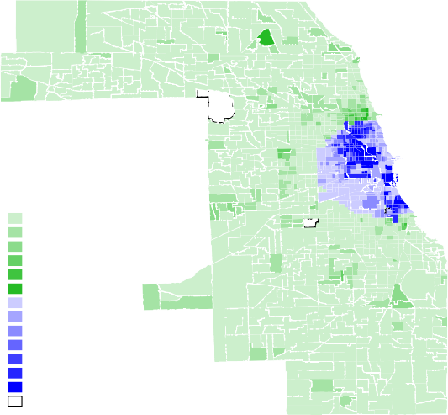
Neighborhood Change is Concentrated in Local Downtown Areas
Chicago
<0%
0%−20%
20%−40%
40% − 50%
50%−60%
60%−100%
<0%
0%−20%
20%−40%
40% − 50%
50%−60%
60%−100%
>100%
No data
Philadelphia
-
-
Boston NYC

Slide 17
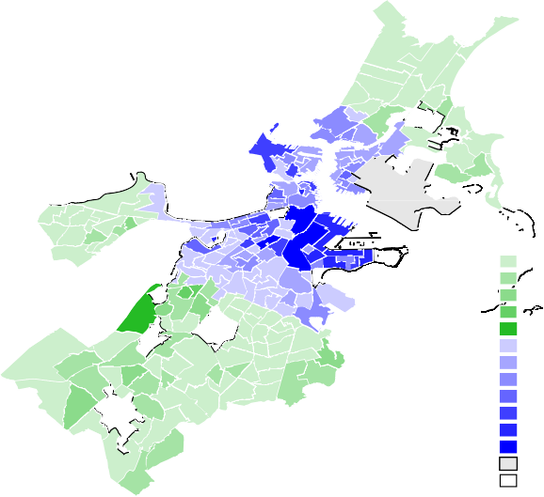
Neighborhood Change is Concentrated in Local Downtown Areas
Boston
<0%
0%−20%
20%−40%
40% − 50%
60%−100%
<0%
0%−20%
20%−40%
40% − 50%
50%−60%
60%−100%
>100%
Parks and Airports No data

Slide 18
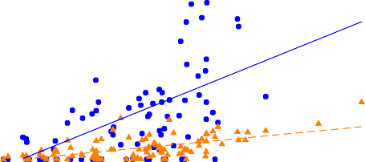
High Income Growth CBSAs saw More Urban “Gentrification”
.5
Tracts with 50% Median Income Growth From 1990 to 2013
.4
.3
.2
.1
0
−.2
−.1
0 .1
Change in Log Average Income
.2
.3
Downtown Tracts Suburban Tracts
Note: Plot depicts the share of a CBSA’s downtown (blue circles) and suburban (yellow triangles) tracts that saw income growth at or above 50% between 1990 and 2013 against the change in that CBSA’s log average income.

Slide 19
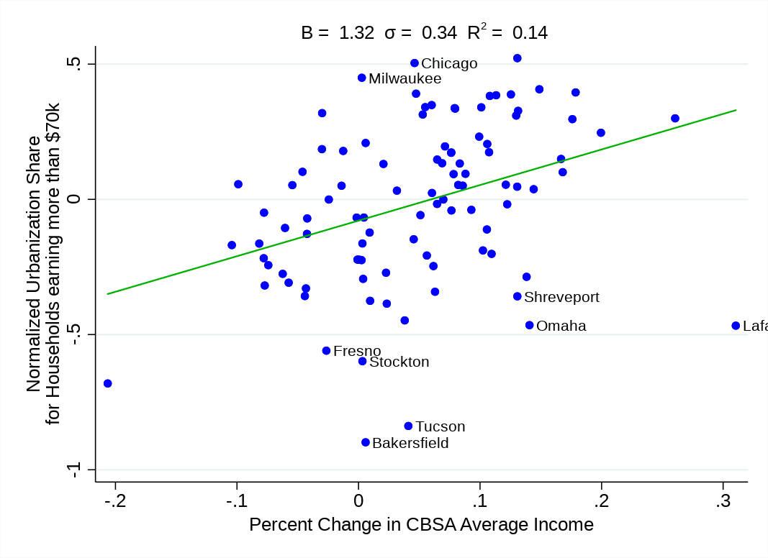
High Income Growth CBSAs saw More U-Shape Amplification
Note: Plot depicts the increase in the urban share of households earning more than $70,000 between 1990 and 2014 relative to the urban share of all households in a CBSA against the change in that CBSA’s log average income.

Slide 20
1 Some Motivating Facts
2 Spatial Equilibrium Model
3 Quantification
4
Counterfactual Analysis

Slide 21
Notion of Space within Model: An Overview
Individuals choose, among other things, a neighborhood where to live indexed by r .
Neighborhoods are indexed by area n (downtown vs. suburbs) and quality j (high vs. low).
An endogenous amount of neighborhoods r in each (n, j ) pair.
Downtown vs suburbs differ in three ways: proximity to jobs, land supply elasticity and endogenous
publicly provided amenities (A_{n} )
Neighborhood quality (Q_{j} ) is such that Q_{H} > Q_{L}.
Individual also draw idiosyncratic preferences over neighborhoods.
Neighborhoods also provide one unit of housing and access to endogenously provided private amenities.
Housing and amenity prices are determined in equilibrium via competitive land markets

Slide 22
Household Problem: An Overview
A household ω with labor income w selects a neighborhood r , residential amenities a, and other numeriere consumption c:
( \ (
\
α
1−α
a c
max U_{r} (ω) = A_{n(r )}Q_{j(r )}b_{r} (ω)
r ,c,a
α 1 − α
subject to
h
a
(1 − τ )w (ω) − T (ω) + Π(ω) ≥ p + P a + c
n(r ) r r
where
� c is homogeneous consumption good; a is consumption of private residential amenities
� A_{n(r )}, Q_{j(r )}, br (ω): intrinsic quality shifters for neighborhood r
� p^{h} : unit housing rents (varies by neighborhood); Pª : amenity price index (varies by neighborhood)
r r
� τ_{n(r )}: commute cost;
� T (ω) - net local taxes/transfers ; Π(ω) - returns from homeownership (Ignore both for now)

Slide 23
Bird’s-eye view: Indirect Utility Formulation
Make a discrete choice of neighborhood r where to live in the city given disposable income:
max V (ω) = [(1
− τ )w − p ] B b (ω)
r
r
r r r r
disp. income
� Housing cost pr , Commuting costs τr
� Endogenous attractiveness/quality Br , Idiosyncratic pref. br (ω)
� Br encompasses An (r ), Qj (r ) and price of neighborhood amenity bundle
Complementarity between quantity of consumption (disp. income) and attractiveness of neighborhood B_{r}
→ Sorting of higher incomes in more attractive neighborhoods

Slide 24
Bird’s-eye view: Neighborhoods (Part 1)
max V (ω) = [(1 − τ )w − p ] B b (ω)
r
r r r r r
Neighborhoods r = housing units + urban amenities.
� Vertically differentiated by location n (Downtown/Suburbs) and type j (High /Low): Bnj
� Within 4 location-type options nj : neighborhoods horizontally differentiated, symmetric: Br = Bnj
� br (ω): idiosyncratic preference shock for neighborhood r : distributed Frechet
Top nest: choice of location-quality option n, j (shape ρ)
Lower nest: choice of neighborhood r among options in n, j (shape γ)
To match U-shape pattern, intuition:
� Ordering of options: Downtown Low < S L < SH < D H

Slide 25
Bird’s-eye view: Neighborhoods (Part 2)
max V (ω) = [(1 − τ )w − p ] B b (ω)
r
r r r r r
Choose a neighborhood characterized by n ∈ {D, S} and j ∈ {H, L}
A_{n} Q_{j}
max V (ω) = [(1 − τ )w − p ] ( \ b
(ω)
r
r n nj α r
P
a
nj
� An ∈ {AD , AS }: location-wide public amenity level
� Qj ∈ {QH , QL}: neighborhood type
� Pª : CES price index, access to urban amenities in other neighborhoods
nj

Slide 26
Attractiveness Depends on Endogeneous Private Amenities
In location n, private developers build neighborhoods (housing+retail space) of High or Low type
� Free entry of developers: supply of neighborhoods Nnj responds to demand
Households value access to amenities in other neighborhoods (e.g. restaurants) :
� CES price index for amenities Pnj
CES amenities
I I
� Depends on variety and access: N I I and (representative) distance to them d
n j nj
n j
� Distance endogenous = related to land area of the location n
� (data) Households prefer consuming amenities of their own n, j type
Love of variety in residential choices: N_{nj} plays the same role as a quality shifter
� Comes from Frechet preference over Nnj neighborhoods
Frechet draws
→ High-w moving in D increase supply and attractiveness of DH neighborhoods that high-w value

Slide 27
Attractiveness Depends on Endogeneous Public Amenities
Recall:
A_{n} Q_{j}
max V (ω) = [(1 − τ )w − p ] ( \ b (ω)
r
r n nj α r
P
a
nj
Local governments invest in public amenities A_{n} in their location
� Collect local tax Tn
� Build non-rival public amenity in location n (schools, parks, fight crime...)
An = Aº (Tn )^{Ω}
n
→ High incomes moving in D increase amenities in both high and low quality neighborhoods of D

Slide 28
House prices are endogenous: land market response
Separate land market in D and S, priced competitively
� Endogenous allocation to High / Low quality neighborhoods
� Transmission channel between H and L neighborhoods within location n
→ High incomes moving in D increase prices in both high and low quality neighborhoods of D
Land supply more inelastic downtown
� Elasticity of land supply En , ES > ED
� Higher price response in D ; limits in-migration in D
� Suburbs grows by sprawl, downtown grows by density → access to amenities easier in D than S
→ High incomes moving in D (vs S) have stronger feedback effect through amenities

Slide 29
Summary: Location Choice Depends on Income
Representative Indirect Utility in n, j
1
¯
N ^{γ} An Qj
nj
Vnj (w ) = ( ) [(1 − τn )w − pnj ]
P
a
α
.; .;
nj
disp.income
”B_{nj} ”
Downtown q_{H}
Indirect utility V_{nj}
Suburbs q_{H}
Suburbs q_{L}
Downtown q_{L}
^{P}DL ^{P}SL ^{P}SH
^{P}DH
Income w

Slide 30
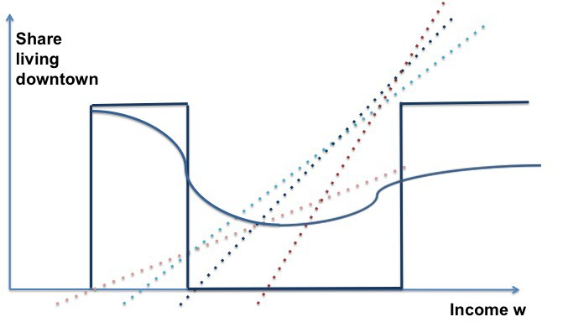
Summary: Location Choice Depends on Income
Representative Indirect Utility in n, j
Location choice
1
¯
N ^{γ} An Qj
nj
¯
ρ
¯
ρ
Vnj (w ) = ( ) [(1 − τn )w − pnj ]
V
DH
(w ) + V (w )
P
a
α
.; .;
λ (w ) =
DL
nj
D
V¯nj (w )^{ρ}
disp.income
n,j
”B_{nj} ”
Downtown q_{H}
Indirect utility V_{nj}
Suburbs q_{H}
Suburbs q_{L}
Downtown q_{L}
^{P}DL ^{P}SL ^{P}SH
^{P}DH
Income w

Slide 31
Location Choice Depends on Income
Location choice shaped by V¯_{nj} (w ) and ρ, shape of Frechet distribution
� ρ governs top nest between n, j options
Notice:
(
\
λ_{nj} (w )/λ_{nj} (w )
(w − p ) / (w − p )
ρ
=
nj nj
λ_{DL}(w )/λ_{DL}(w ) (w − p_{DL}) / (w − p_{DL})
� Propensity of high vs low income to live in a given area depends on disposable income w − pnj
� ρ governs strength of non-homotheticity
� High ρ: location choices are strongly income-dependent

Slide 32
Equilibrium
An equilibrium of the model is:
� a distribution of location choice by income λn,j (w )
� a number of neighborhoods of each type Nn,j
� land, housing and amenity prices
such that:
� Households choose their location to maximize utility, and choose consumption (a, c) optimally
� Developers and landowners maximize profits
� The markets for land, housing and amenities clear
� Developers make zero profits
� Local government budget is balanced

Slide 33
Key Model Outcomes
1. Share of workers choosing to live downtown depends on income:
V¯_{DH} (w )^{ρ} + V¯_{DL}(w )^{ρ}
λ_{D} (w ) = ),
V¯ (w )^{ρ}
n∈{D,S },j∈{H,L}
nj
2. Welfare measure for income w -workers in equilibrium t:
� Representative utility at every income level w: function maps income to welfare for equilibrium t:
l 1
_{ρ}
ρ
V ^{(t)}(w ) =
V^{¯ (t)}(w )
nj
n,j
� Dollar-term measure: compute Compensating Variation for income percentile i between t = 1990 and
t = 2014:
CV (i ) = e(p²⁰¹⁴, V ²⁰¹⁴(i )) − e(p²⁰¹⁴, V ¹⁹⁹⁰(i ))

Slide 34
Distributional effects of a shock
In response to a shock (e.g., income distribution change)
� Compute new neighborhood amenities, prices, and resulting sorting patterns
� Compute welfare change for all w (compensating variation)
� Maps income inequality change to welfare inequality change, accounting for spatial responses

Slide 35
Key Parameters
ρ: Rrechet parameter on choice of (n, j ) pairs. Governs strength of non-homotheticity with income.
γ: Frehet parameter on choice of neighborhoods within (n, j ) pairs. Governs strength of love of variety effects.
α: Cobb-Douglas parameter governing private amenity share. Makes private amenities more important.
σ: Elasticity of substitution of private amenities across neighborhoods. Governs strength of ”love of density” effects.
E_{n} : Land supply elasticities for downtown and suburbs. Governs house price response.
τ_{n} : Commuting costs for downtown and suburbs.

Slide 36
1 Some Motivating Facts
2 Spatial Equilibrium Model
3 Quantification
4
Counterfactual Analysis

Slide 37
Quantification Strategy
Stage 1: Quantification of Model Elasticities
� Estimation of key elasticities
� Calibration of other elasticities
Stage 2: Method of moments
� Calibrate remaining parameters to match location choices by income and relative house prices in 1990

Slide 38
From model to data: key parameters that mediate impact of a shock
Estimate/ calibrate parameters that govern:
Costs
� Housing supply elasticities:
* E_{D} = 0.60, E_{S} = 1.33 (Saiz elasticities, low vs high density)
� Commute cost (income share): τD =0.044, τS =0.059 (2009 NHTS)
Non-homothetic location choice
� next: estimate ρ
Endogenous amenities response:
� Amenity share: α = 0.15 (CEX)
� Public amenity response: calibrated from literature. (Ω = 0.05)
� Access to a variety of amenities and neighborhoods: next

Slide 39
Empirical Notions of Space
Neighborhood r_{nj} in CBSA
� Census tracts within an area-quality tier pair
Area n ∈ {D, S} within CBSAs:
� D = all tracts close to center city of main CBSA containing 10 percent of CBSA population
� S = all remaining tracts in CBSA
Quality j ∈ {H, L} measured at the tract-level using:
� density of high-quality restaurant chains
� college share 40% (top 20 percent of all tracts in 2000)

Slide 40
Non-homotheticity in location choice is governed by ρ
Take estimating equation for model parameter ρ directly from the model:
ψcj
( \ ( \
share of w in Dj w − p
share of w in Sj
B
∆ ln
= ρ∆ ln
Dj
+ ∆ ln
Dj
+E
w − p_{Sj}
BSj
cjw
c c
� How much more high-w are willing to choose a high quality-high price neighborhood?
Threat to identification:
� Unobserved amenities targeting e.g. richer households could attract them disproportionally
IV strategy:
� Bartik income growth shock, interacted with income bracket dummy

Slide 41
Non-homotheticity in location choice ρ
Visualize source of variation: reduced-form regression
� Location choice on Bartik shock, income bracket by income bracket
� High-w tend to relocate more to downtown as a response to a city-wide income shock.
( \
share of w in D share of w in S
Bartik
∆ ln
= α + β ∆Income + E
w w c
cw
c
20
10
Elasticity
0
−10
5000
10000 25000
60000 100000 175000
Median HH Income within Bracket (log scale)
95% CI Coefficient
� The model parameter ρ identified by the corresponding IV regression.

Slide 42
Non-homotheticity in location choice is governed by ρ
Estimating equation for model parameter ρ:
( \
( \
share of w in D,j share of w in S,j
w − p
∆ ln
= ρ∆ ln
Dj
+ ψ + E
w − p_{Sj}
cj cjw
c
c
 | Quality Definition: College Share | Quality Definition: Restaurant Chain
 | (1) (2) OLS IV | (3) (4) OLS IV
ρˆ | 1.34 3.19 | 1.38 3.38
 | (0.09) (0.20) | (0.13) (0.27)
^{δ}cj | Yes Yes | Yes Yes
_{R}2
0.84
0.87
KP F-Stat |  | 45.37 |  | 48.02
Obs | 1,599 | 1,599 | 1,434 | 1,434
Notes: Data from 2000 and 2014 in 100 largest CBSAs. Observations are CBSA-population weighted. Standard errors in parentheses. KP F-Stat = Kleinberger-Papp Wald F statistic.

Slide 43
Parameters that govern amenity consumption
Derive gravity regression for trips to amenities from model:
Dummy
θr +θ_{r} I
I
^{( \} ₎
( \
( \
j(r )I=j(r )
_{p}a
NTrips_{rr} I
drr ^{I}
_{r} I
ln
= ln β_{j(r )j(r} I₎ −δσ ln
+ σ ln
_{p}a
.
NTrips
d
rr rr r
� Origin and destination fixed effect to control for unobserved quality and price differences
� Dummy consuming amenities in a neighborhood of different quality than own
Data from smartphone geolocations
� 9.6 billion visits to commercial establishments from 87 million devices
� Select trips: home → non-tradable services (restaurants, gyms, theaters, etc.)
* side note: 81% trips are in same quality neighborhood as home

Slide 44
Gravity Parameter for Amenity Demand (δσ)
( \
( \
Trips I
d
I
ln
rr
= δ
I + θ + θ I − σδ ln
rr
+ E (w )
Tripsrr
j(r )/=j(r )
r r
drr
cj
Quality Definition: College Share
Quality Definition: Restaurants Chain
(1)
All
(2)
Home
(3)
Weekend
(4)
(5)
All
(6)
Home
(7)
Weekend
(8)
Home-Home
Home-Home
δ^{ˆ}σ
-1.57
(0.00)
-1.42
(0.00)
-1.20
(0.00)
-1.18
(0.00)
-1.56
(0.00)
-1.40
(0.00)
-1.18
(0.00)
-1.17
(0.00)
^{β}j(r )I=j(r ^{I})
-0.14
(0.00)
-0.12
(0.00)
-0.10
(0.00)
-0.09
(0.00)
-0.04
(0.00)
-0.03
(0.00)
-0.03
(0.00)
-0.03
(0.00)
_{R}2
Obs
0.91
22,791,347
0.87
6,403,153
0.88
11,924,874
0.85
3,050,752
0.91
19,858,033
0.87
5,645,813
0.88
10,419,101
0.85
2,696,680
Notes: Standard errors are clustered by home tract (r ) and visit tract (r ^{I}).
Estimate δσ = 1.4
Separate elasticity of substitution from commuting frictions using σ = 6.5, hence δ = 0.2

Slide 45
Elasticity of Substitution within Neighborhood Type (γ)
Bound estimate of γ between ρ = 3.3 and σ = 6.5
� Nested structure of model implies: ρ < γ
� Research shows that neighborhood segregation is higher than segregation of consumption in residential amenities (like restaurants, groceries, etc.). Implies: σ > γ
Conservative baseline: γ = 6.5 (show robustness to other values including γ = ∞)

Slide 46
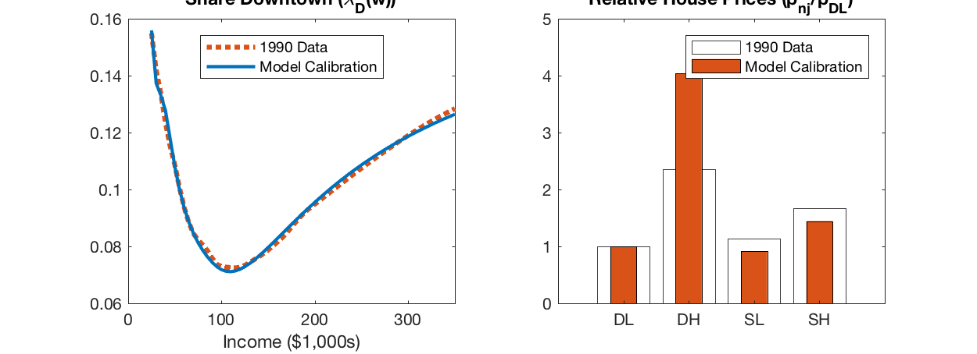
The calibrated model replicates initial spatial sorting patterns well
Calibrate initial qualities B_{n,j} and initial prices p_{n,j} to best match:
� U-shaped distribution of location choices and relative prices in 1990
� given distribution of income and elasticities

Slide 47
1 Some Motivating Facts
2 Spatial Equilibrium Model
3 Quantification
4
Counterfactual Analysis

Slide 48
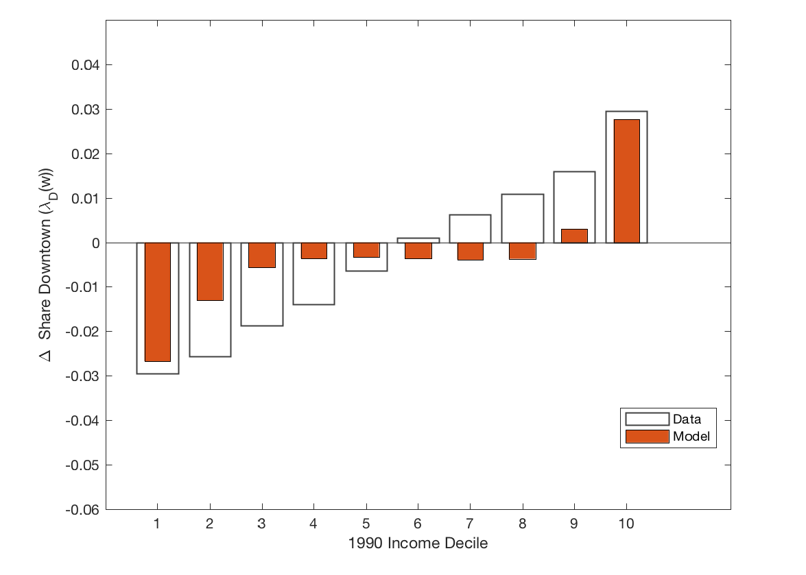
Shift in income distribution can explain a large share of spatial resorting
Income growth 1990-2014 by 1990 income decile
Income Growth (%)
∆ share living downtown by 1990 income decile
25
20
15
10
5
0
-5
Income Growth (%)
1
2
3 4 5 6
7
8
9
10
1990 Income Decile
Our mechanism is one of several drivers behind urban
Per cap. income growth: +10%
90-10 income gap increase: +22pp
gentrification
Jobs (Edlund et al. 2016, Su 2017), crime drop in
1990s (Ellen et al. 2017)

Slide 49
Mechanisms: price and quality changes
Price Change (pˆn,j )
Quality Change (B^{ˆ}n,j )
House Prices ( p_{nj,t} ) (%)
B (%)
nj,t
8
20
7
6
15
5
10
4
3
5
2
1
0
0
-5
DL
DH
SL
SH
DL DH SL SH
With income distribution changes, prices rise downtown and low quality neighborhoods gentrify
� Prevalence of high quality neighborhood increases in D, and their quality increases
� Low quality neighborhoods barely see a quality change, on net - but there is less of them
Price and quality effects disproportionately hurt the poor.

Slide 50
Urban spatial sorting reinforces welfare inequality
Compute change in welfare (CV) accounting for spatial responses. Plot
CV-∆Income Income1990
All Households
Renters Only
2
2
Income)/Income ₁₉₉₀ (%)
Income)/Income ₁₉₉₀ (%)
1.5
1.5
1
1
0.5
0.5
0
0
(CV -
-0.5
(CV -
-0.5
-1
-1
1 2 3 4 5 6 7 8 9 10
1990 Income Decile
1 2 3 4 5 6 7 8 9 10
1990 Income Decile
Change in income inequality understates the change in well-being inequality by about 10%
Homeowners are better off that renters - as they reap house price appreciation

Slide 51
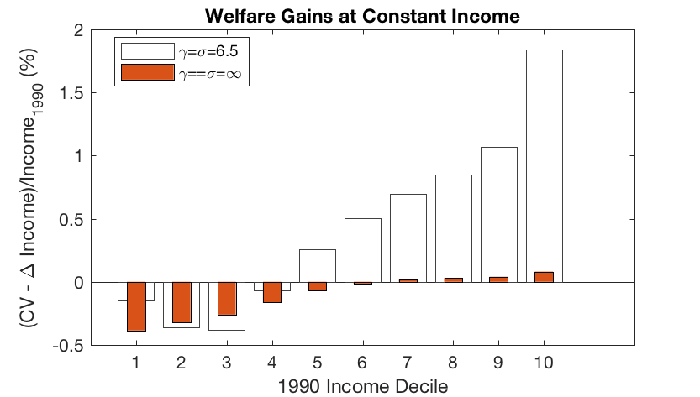
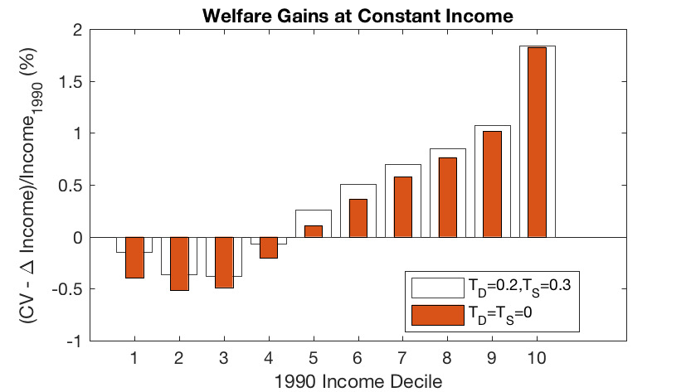
Importance of Amplification Mechanisms
Shut down endogenous private amenities
Shut down endogeneous public amenities
About 3/4 of the welfare effect from amplification
Amplification effects only rich (love of variety)
Public amenity response
Mitigates welfare losses for the poor
Redistributive, but small effects

Slide 52
Robustness of ρ (Elasticity of Sub. between Neighborhood Types
All Households
Renters
 | Top Decile | Bottom Decile | Diff | Top Decile | Bottom Decile | Diff
Base Specification (ρ = 3.3) | 1.84 | -0.14 | 1.98 | 1.07 | -0.51 | 1.58
ρ = 2.5 | 1.69 | -0.06 | 1.75 | 1.02 | -0.05 | 1.52
ρ = 4.0 | 2.04 | -0.12 | 2.15 | 1.23 | -0.48 | 1.71

Slide 53
Robustness of γ (Elasticity of Sub. within Same Type Neighborhoods)
All Households
Renters
 | Top Decile | Bottom Decile | Diff | Top Decile | Bottom Decile | Diff
Base Specification (γ = 6.5) | 1.84 | -0.14 | 1.98 | 1.07 | -0.51 | 1.58
γ = 5 | 2.08 | -0.06 | 2.13 | 1.30 | -0.45 | 1.75
γ = 8 | 1.71 | -0.18 | 1.90 | 0.94 | -0.55 | 1.49
γ = ∞ | 1.25 | -0.35 | 1.60 | 0.49 | -0.69 | 1.18

Slide 54
Robustness of α (Share of Spending on Private Amenities)
All Households
Renters
 | Top Decile | Bottom Decile | Diff | Top Decile | Bottom Decile | Diff
Base Specification (α = 0.15) | 1.84 | -0.14 | 1.98 | 1.07 | -0.51 | 1.58
α = 0.05 | 1.69 | -0.09 | 1.77 | 1.04 | -0.26 | 1.30
α = 0.25 | 1.92 | -0.15 | 2.07 | 1.09 | -0.64 | 1.73

Slide 55
Future Predictions?
Thought Experiment: Start in 2014 and increase income of everyone by x %
All Households
Renters
 | Top Decile | Bottom Decile | Diff | Top Decile | Bottom Decile | Diff
Additional ∆Income = 10% | 1.71 | -0.59 | 2.39 | 4.41 | 2.49 | 1.92
Additional ∆Income = 20% | 7.02 | -1.57 | 8.59 | 8.79 | 1.11 | 7.68
Additional ∆Income = 30% | 10.64 | -2.66 | 13.30 | 10.88 | -1.79 | 12.67

Slide 56
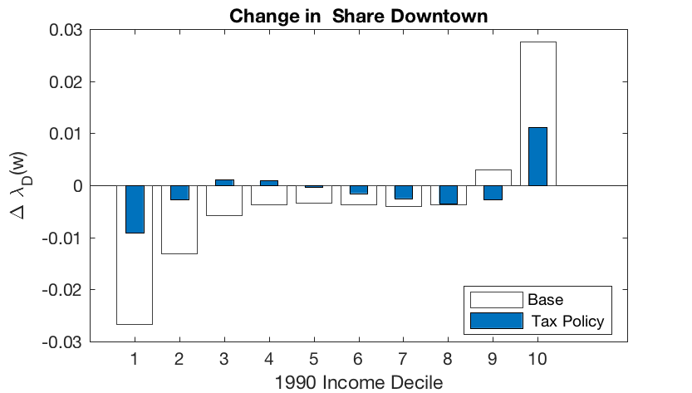
Counterfactual Policy Analysis
Policy: 5% tax on DH redistributed to subsidize DL rents
Change in U-shape with and without policy
Change in 2014 welfare with policy
Change in CV induced by policy
0.05
(% of Income )
1990
0
-0.05
-0.1
-0.15
-0.2
-0.25
-0.3
1 2 3 4 5 6 7 8 9 10
Population Percentile (sorted by income)
Policy
CV - CV
Large effect on curbing gentrification and
But limited impact on welfare
maintaining social diversity
Large share of increase in welfare inequality
remains

Slide 57
Conclusion
Rising income inequality likely to significantly contribute to neighborhood changes and spatial resorting within large U.S. cities
Gives rise to gentrification-like phenomenon, with negative welfare effects on poorer households
Ignoring within-city spatial responses, measured income inequality growth understates well-being inequality growth by about 10%

Slide 58
Thank you!

Slide 59
Household Value Access to a Variety of Amenities
Demand for amenities is CES:
/
\ σ
σ−1
\
a_{r} =
1
σ−1
β (a
)
σ
I rr ^{I}
σ
rr
_{r} I
� a_{rr} I consumption of amenities in neighborhood r ^{I} by residents of r
� β_{rr} I captures ’Psychological distance”: households living in j neighborhoods prefer amenities in j
Cost of consuming amenities in r depends on distance to neighborhood r :
_{d} δ˜ _{p}a
rr ^{I} r ^{I}
(
(
\
\
1 1−σ
),
1−σ
a
−δ˜ a
CES Price index for neighborhood-r residents: P =
_{n}I_{,j}I Nn^{I}j^{I} βjj^{I}
d_{nn}I p_{n}I_{j}I
back
nj

Slide 60
Neighborhood Attractiveness is Endogeneous
b_{r} (ω): idiosyncratic preference shock for neighborhood r
Distributed Frechet
� Top nest: choice of location-quality option n, j (shape ρ)
� Lower nest: choice of neighborhood r among options in n, j (shape γ)
Household value richer choice set of neighborhood
1
� N ^{γ} acts as a quality shifter
back
nj

Slide 61
Financial Literacy Seminar Series _______________________________________
Income Growth and Distributional Effects of Urban Spatial Sorting
Erik Hurst
University of Chicago

